Slide 1

DriverPass
System Analysis
Matthew Wood
Notes:
[No speaker notes required for this slide.]

Slide 2

System Requirements
Key Features of Your New System
Online Training Hub: Students can take online classes and practice tests with content kept current via automatic DMV updates.
Easy Scheduling: Students and staff can quickly schedule, modify, or cancel two-hour driving lessons.
Secure Payments: The system integrates with a secure, third-party service to process credit card payments.
Centralized and Cloud-Based: All data is managed in a central, cloud-based database to handle backup and security.
Full Reporting: You can easily download reports (activity, financial) in formats compatible with software like Excel.
Notes:
"This slide summarizes the core capabilities we are building. The Online Training Hub directly addresses the market gap by offering structured classes and practice tests. For operations, the Easy Scheduling feature allows both students and your secretary to book two-hour lessons efficiently. Crucially, the system includes Secure Payments using a specialized service, so we don't store sensitive financial information. Because the system is Cloud-Based, we manage the complexity of security and data backups for you. Finally, you will have Full Reporting access to download all necessary data for your offline work."

Slide 3
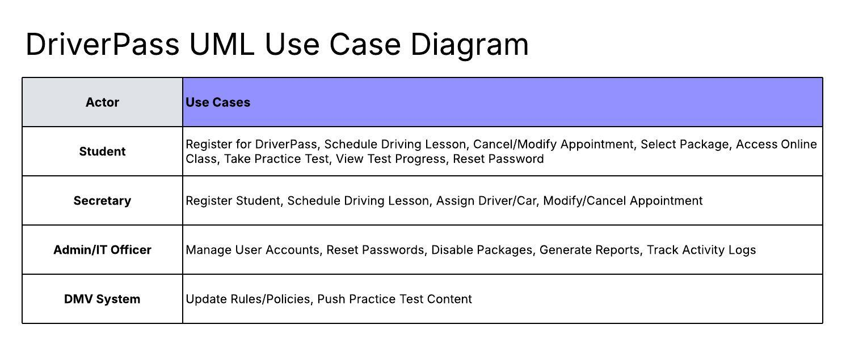
Use Case Diagram
[Insert your use case diagram here.]
Who Uses the System and What Can They Do?
Notes:
"This map shows the four main groups of people, or 'Actors,' who use the system, and what specific tasks they can perform. The Student is empowered to handle most of their training needs online, from signing up to taking a practice test. Your Secretary has tools designed for fast, accurate registration and scheduling when a customer calls in. Your Admin/IT Officer has the high-level controls, such as blocking an account if an employee leaves or easily turning packages on or off for sale. The DMV System is an important external partner, ensuring your content is always compliant by automatically sending updates to your training materials."

Slide 4
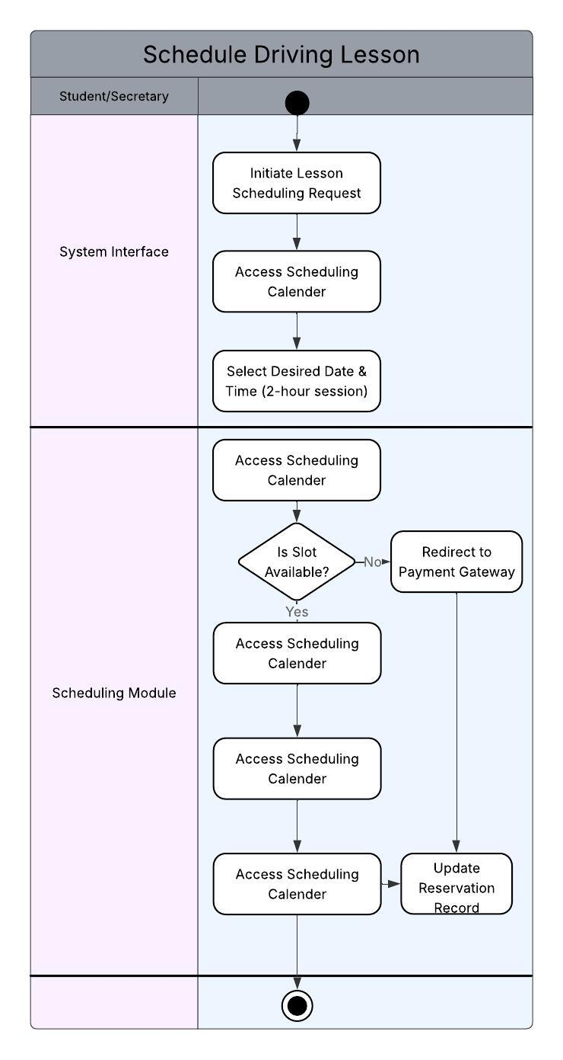
Activity
Diagram
Notes:
"This diagram shows the step-by-step process for booking a driving lesson, which is designed to be error-free. When a time is requested, the system automatically checks for three key items at the same time: Driver availability, Car availability, and the Student's payment status. This prevents overbooking. Once validated, the system securely processes the payment (if necessary) and instantly confirms the reservation. This ensures that every lesson is accurately tracked, providing you with reliable scheduling data."

Slide 5
Security
Protecting Your Data and Business
Role-Based Access: Every employee and student has different access levels, ensuring they only see what is required for their job.
Administrative Control: Your IT Officer has full privileges to manage all accounts, including resetting passwords or blocking access if an employee leaves.
Payment Security: We use a secure, external payment service to protect all credit card information, which is transmitted using strong encryption.
Activity Tracking: Every action in the system is logged and attributed to the specific user who made the change for complete accountability.
Notes:
"Security is integrated into the system's core. We use Role-Based Access to control what different employees can see and do; a driver cannot access financial reports, for instance. This protects your data internally. For managing staff, your administrator has full control to reset passwords and instantly block a driver's access if they leave, securing your business. To handle customer payments, we chose an external payment service, which means we don't store sensitive credit card numbers ourselves. Finally, Activity Tracking ensures that every reservation, cancellation, or change is logged with the user's name, providing complete transparency over who did what."

Slide 6
System Limitations
What the System Will NOT Do (Initial Phase)
No DMV Submission: The system will receive content updates from the DMV but will not submit any data, certifications, or official information back to the DMV.
Limited Package Customization: You can easily disable or enable existing training packages, but you cannot build or create new ones without a developer's help.
No Offline Modification: You must have an active internet connection to make or modify any data (like reservations) to prevent conflicting records.
Timeline Constraint: Features are limited to the core requirements to ensure delivery by the planned end date of May 10th.
Notes:
"We want to be clear about the scope of this first phase. The system has four main limitations for now. First, while we receive DMV Updates, the system will not submit data like certifications to the DMV. Second, you can turn training packages on or off as needed, but you cannot create a brand-new package from scratch; that would require development work. Third, the system will not work offline for making changes to the schedule, as this is necessary to ensure the scheduling data is always accurate and prevents booking conflicts. These limitations help us keep the project within the schedule and deliver the core system by the May 10th final date."

